Slide 1
Android test

Slide 2
1. Local unit test

Slide 3

Located at module-name/src/test/java/.
Run on your machine's local Java Virtual Machine (JVM).
Using when your tests have no Android framework dependencies or when you can mock the Android framework dependencies.
It does not need device or emulator for run the test.
Example: Database connections, input & output of method…

Slide 4
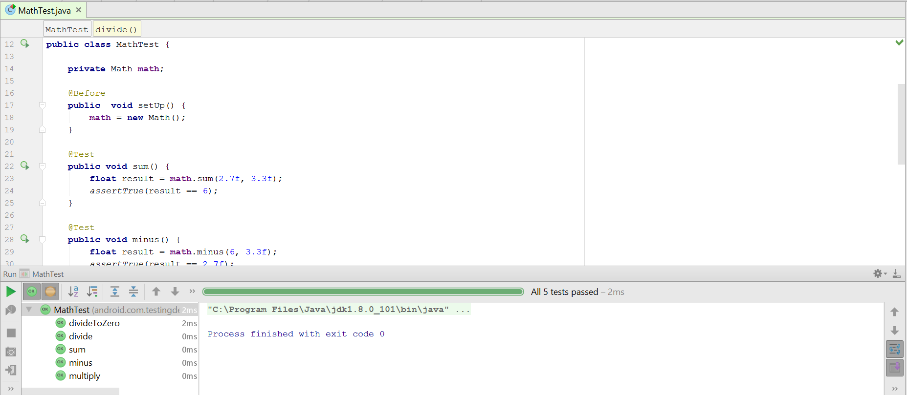
Example:

Slide 5
2. Instrumented Unit Tests

Slide 6
Located at module-name/src/androidTest/java/.
Run on a hardware device or emulator.
Use these tests when writing integration and functional UI tests to automate user interaction, or when your tests have Android dependencies that mock objects cannot satisfy.
It needs device or emulator for run the test.
Example: access to view, activity…

Slide 7
You should create instrumented unit tests if your tests need access to instrumentation information (such as the target app's Context) or if they require the real implementation of an Android framework component (such as a Parcelable or SharedPreferences object).

Slide 8
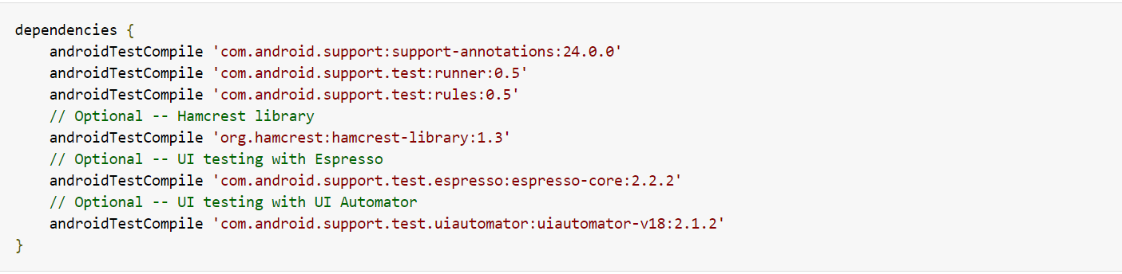
Example:
Add dependencies in build.gradle

Slide 9
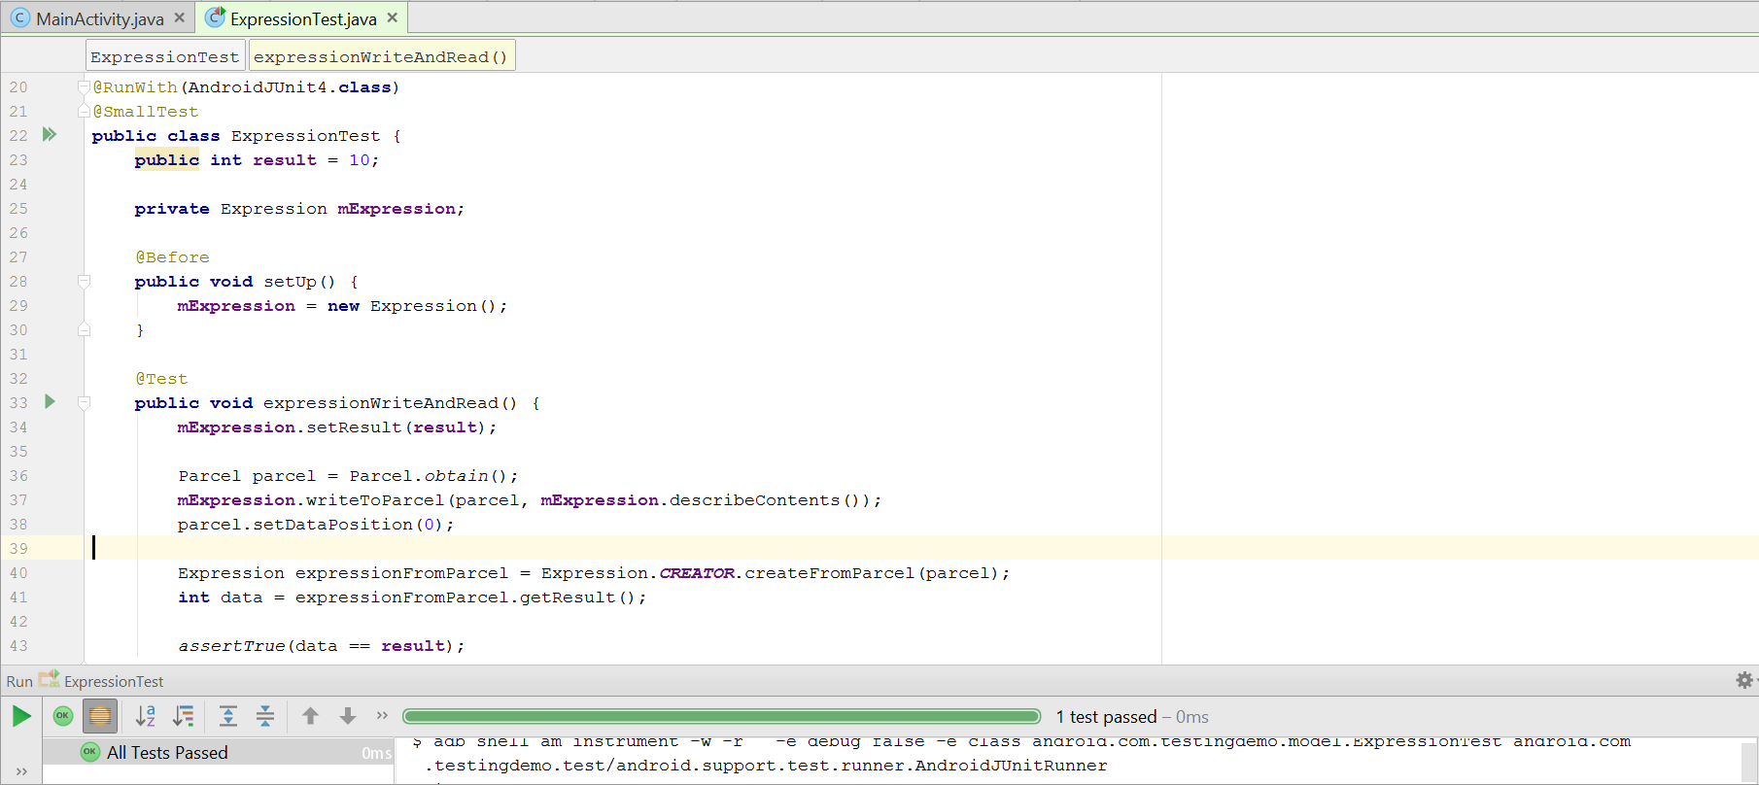
Example:

Slide 10
2.1. Run your tests with Firebase Test Lab

Slide 11
Using Firebase Test Lab, you can simultaneously test your app on many popular Android devices and device configurations (locale, orientation, screen size, and platform version).
These tests run on physical and virtual devices in remote Google data centers.

Slide 12
Example:
Click Run -> Edit Configurations from the main menu.
Select Android Intrumented Tests, click Add new (+).
In the Android Test configurations dialog:
Enter or select detail of yout test: name, module type…
Connect to Google Firebase.
Select Firebase project from list.
Create and configure a test matrix:
Next to the Matrix Configuration drop-down list, click Open Dialog
Click Add New Configuration (+)
In the Name field, enter a name for your new configuration
Select the device(s), Android version(s), locale(s) and screen orientation(s) that you want to test your app with. Firebase Test Lab will test your app against every combination of your selections when generating test results.
Click Ok to save your configuration.

Slide 13
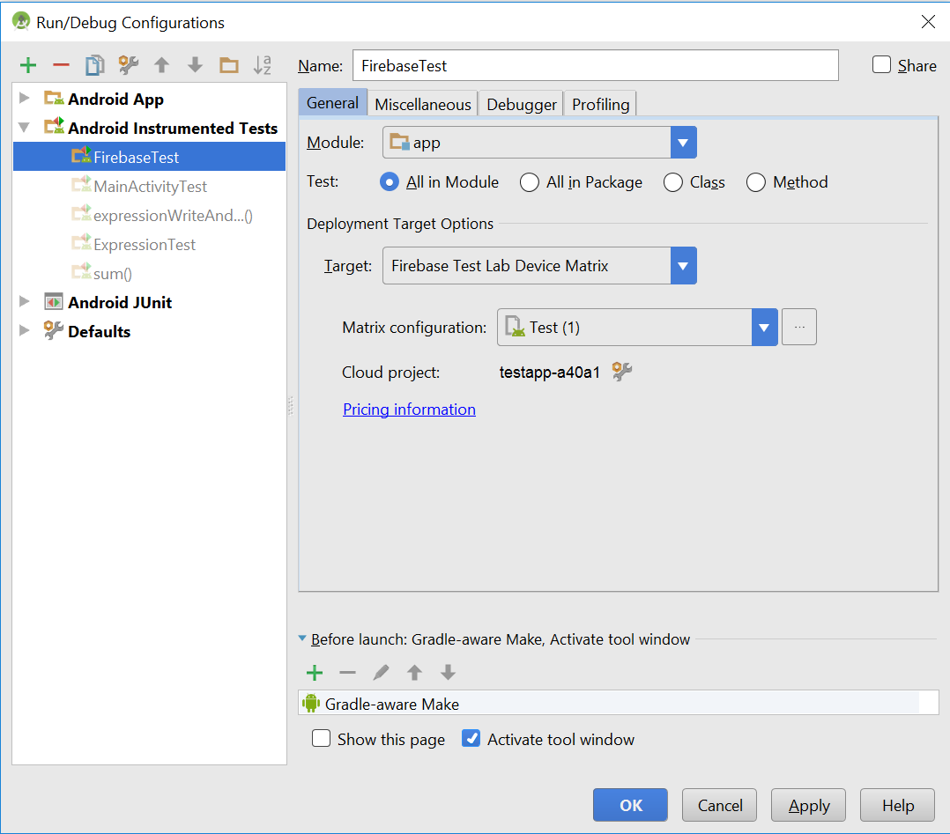

Slide 14
3. Automating User Interface Tests

Slide 15
User interface (UI) testing lets you ensure that your app meets its functional requirements and achieves a high standard of quality such that it is more likely to be successfully adopted by users.

Slide 16

Example:

